Slide 1
25 PIECE PUZZLE OF WORK-BASED LEARNING
Educating for Careers Conference
March 2013
Ruth Kwake, RN, BSN, MAEd.
Guidance Counselor
Health & Environmental Academy of Learning
Cathedral City High School
Donna Sturgeon. BA, BSEd
Career Pathways Initiative
Coachella Valley Economic Partnership
Notes:
Introductions:
Summary of our backgrounds & how we began to work together.
We welcome visitors who would like to meet with our teams, attend an Industry council meeting.
Plan for the workshop:
Information & examples of our efforts, learning experiences & successes
Opportunity to work on your own puzzle pieces

Slide 2
25 PIECE PUZZLE OF WORK-BASED LEARNING
WORK BASED LEARNING IS NOT:
Simply putting a student on a job site
Just the responsibility of teachers, schools or ROCP/CTE programs
Reliant only on Industry professionals or Workforce Development Programs
WORK BASED LEARNING IS:
Connecting students to the real world of work
A partnership between students, parents, teachers, educational programs and industry partners
A combination of academic, personal, and CTE preparation
Notes:
Too often work-based learning is an isolated experience. It may be limited to opportunities within an ROCP/CTE class or program, or a school based job shadowing program, or to a single grade level experience in an academy.
Ideally, it begins even before high school, helping students to think ahead to their goals/choices in a high school setting which motivates academic performance.
It builds throughout the high school experience from generalized, broad experiences and acquisition of knowledge & skills towards a “capstone” experience which is dependent upon theoretical knowledge, technical skills and 21st century personal skills that put students into real-world settings working with professionals in their career field.
Anyone want to share a couple sentences of a favorite work-based learning idea?
Accomplishing this requires the commitment and expertise of many people.
Students & parents commit to the process of achieving academic and personal skills
Teachers provide knowledge and training, both generalized & career specific
Educational partners provide students with long-term goals to achieve their career goals.
Industry partners provide expertise, knowledge, time, and environments in a HUGE variety of ways.

Slide 3
THE PUZZLE PIECES
8th GRADE
CAREER
EXPLORATION
TRIP
8TH GRADE
ON-LINE
CAREER
EXPLORATION
9TH GRADE
CAREER
PROJECT
9TH GRADE
LOCAL
COMMUNITY COLLEGE
TRIP
9TH GRADE
PROFESSIONAL
INTERVIEW DAY
10TH GRADE
GUEST
SPEAKERS
10TH GRADE
3-DAY COLLEGE TRIP
10th GRADE
SALTON SEA
RESEARCH &
FORUM
COMMUNITY
SERVICE
10TH GRADE
SERVESAFE
CERTIFICATION
Regional
Collaboration
11TH GRADE
ROP/CTE
CERTIFICATION
11TH GRADE CERT TRAINING WITH CCFD
11TH GRADE JOB SHADOW DAY
SCHOOL
BLOOD
DRIVES
11TH
GRADE
MENTORSHIPS
11TH GRADE
COLLEGE
VISITS
POST-SECONDARY
PLANNING
MIDDLE SCHOOL
JUNIOR CTSO
(JUMP)
CAL-HOSA
SLC
AND
HOSA NLC
12th
GRADE
INTERNSHIPS
SCHOOL
DISASTER
DRILL
EXTERNSHIPS FOR
EDUCATORS
HIGH SCHOOL
CTSO
HOSA
SKILLS USA
12TH GRADE
COMMUNITY
HEALTH FAIR
Notes:
Work-based learning has a place in every grade level, and should include collaboration among many groups, but making it work involves putting the pieces of the puzzle together.
We’ll be talking about the 25 pieces of our work-based learning puzzle and how we make it fit the needs of our academy as well as the regional health academy collaborative.

Slide 4
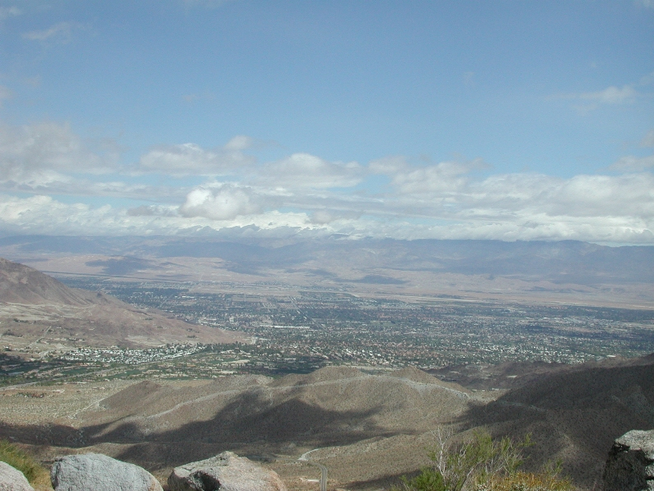
Education is Economic Development: “Advancing an Educated Workforce for a Thriving Regional Economy” March 12, 2013 Educating for Careers Conference-Sacramento

Slide 5
CVEP Workforce Pipeline Strategy:
Align education and economic development strategies.
Link education programs pre-school through graduate school (P-20) to provide multiple pathways to college and career.
Connect business partners to career pathways programs, leverage resources
3 Industry Councils in Healthcare/Life Sciences, Energy/Clean Tech and Arts, Media & Entertainment
Convene business and education to prepare the future workforce for targeted clusters.
Facilitate Regional Strategies to increase opportunities for students learning in career-relevant pathways tied to target industry clusters.
Guide and Invest in the Development of each segment of the pathway
Support High Impact Practices to ensure student success across the pipeline
Direct Financial Support – Scholarships and student services
Healthcare/Life Science
Energy / Clean Tech
Arts, Media & Entertainment
Notes:
Donna

Slide 6
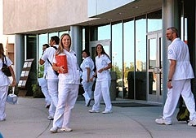
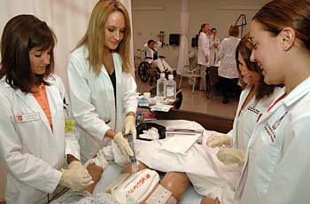
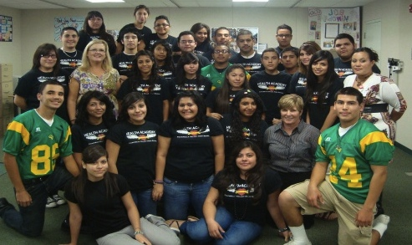
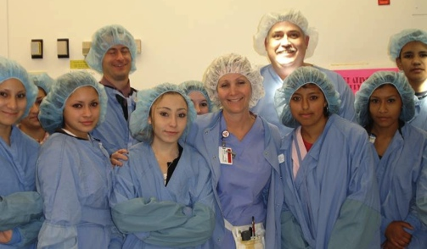
Preparing the Pipeline:
The Healthcare Industry Council
11,453 Healthcare Jobs
CSUSB Palm Desert Nursing Students
COD Nursing Students
CSU San Bernardino
UCR, Med Scholars, Med School
Private Universities
Scholarships/ Matching Partners
COD
RivCo Office of Ed / ROP
RivCo EDA /WDC
Private Schools
Scholarships
Coachella Valley High School
Health Academy Students
6 High School Health Academies
CVUSD: CVHS
DSUSD: LQHS & HIS, PDHS
PSUSD: CCHS & PSHS
Raymond Cree Middle School Tours
Desert Regional Medical Center
PSUSD Middle School JUMP Programs & Career Explorations
DSUSD K-8 Pre Med Magnet
Notes:
Donna

Slide 7
Regional WBL
Notes:
Donna

Slide 8
25 PIECE PUZZLE OF WORK-BASED LEARNING
MIDDLE SCHOOL
JUNIOR CTSO
(JUMP
8th GRADE
CAREER
EXPLORATION
TRIP
8TH GRADE
ON-LINE
CAREER
EXPLORATION
Notes:
Begin in 8th grade, include classroom, community, industry & college readiness
Donna – career exploration trips, how they work.
Ruth – use of exploration trips as recruitment tool. Use of careercruising in middle schools-district wide is part of plan that builds up thru high school.
JUMP – how it works, how it ties together MS & HS students. Talk about regional JUMP event

Slide 9
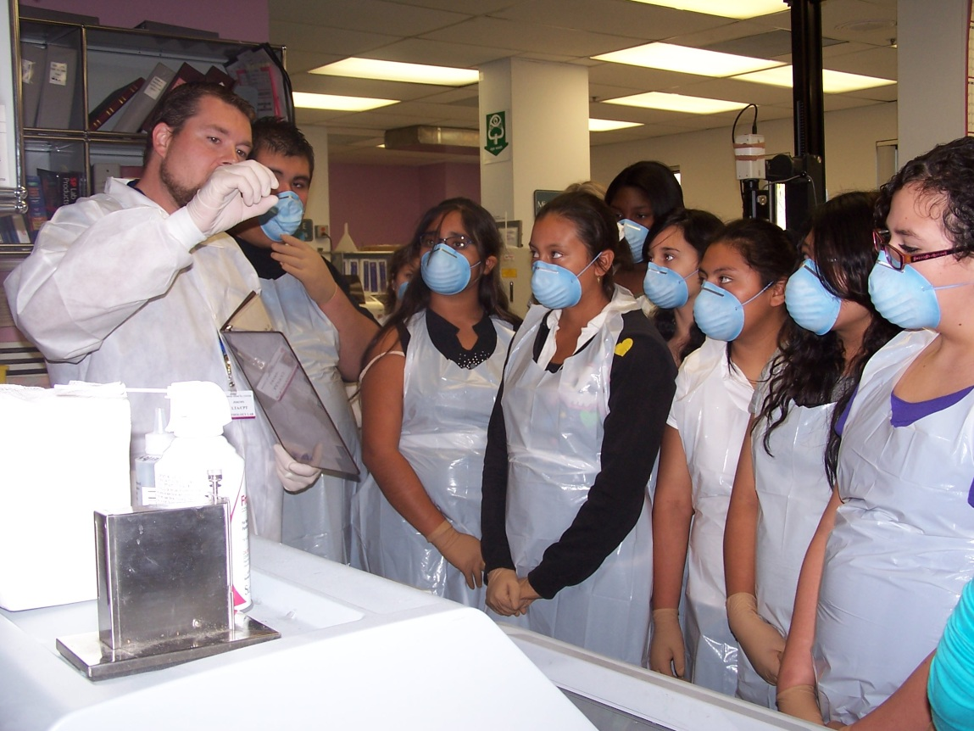
CAREER EXPLORATION FIELD TRIP
8TH GRADERS SEE THE HOSPITAL LABORATORY, UP CLOSE AND PERSONAL

Slide 10
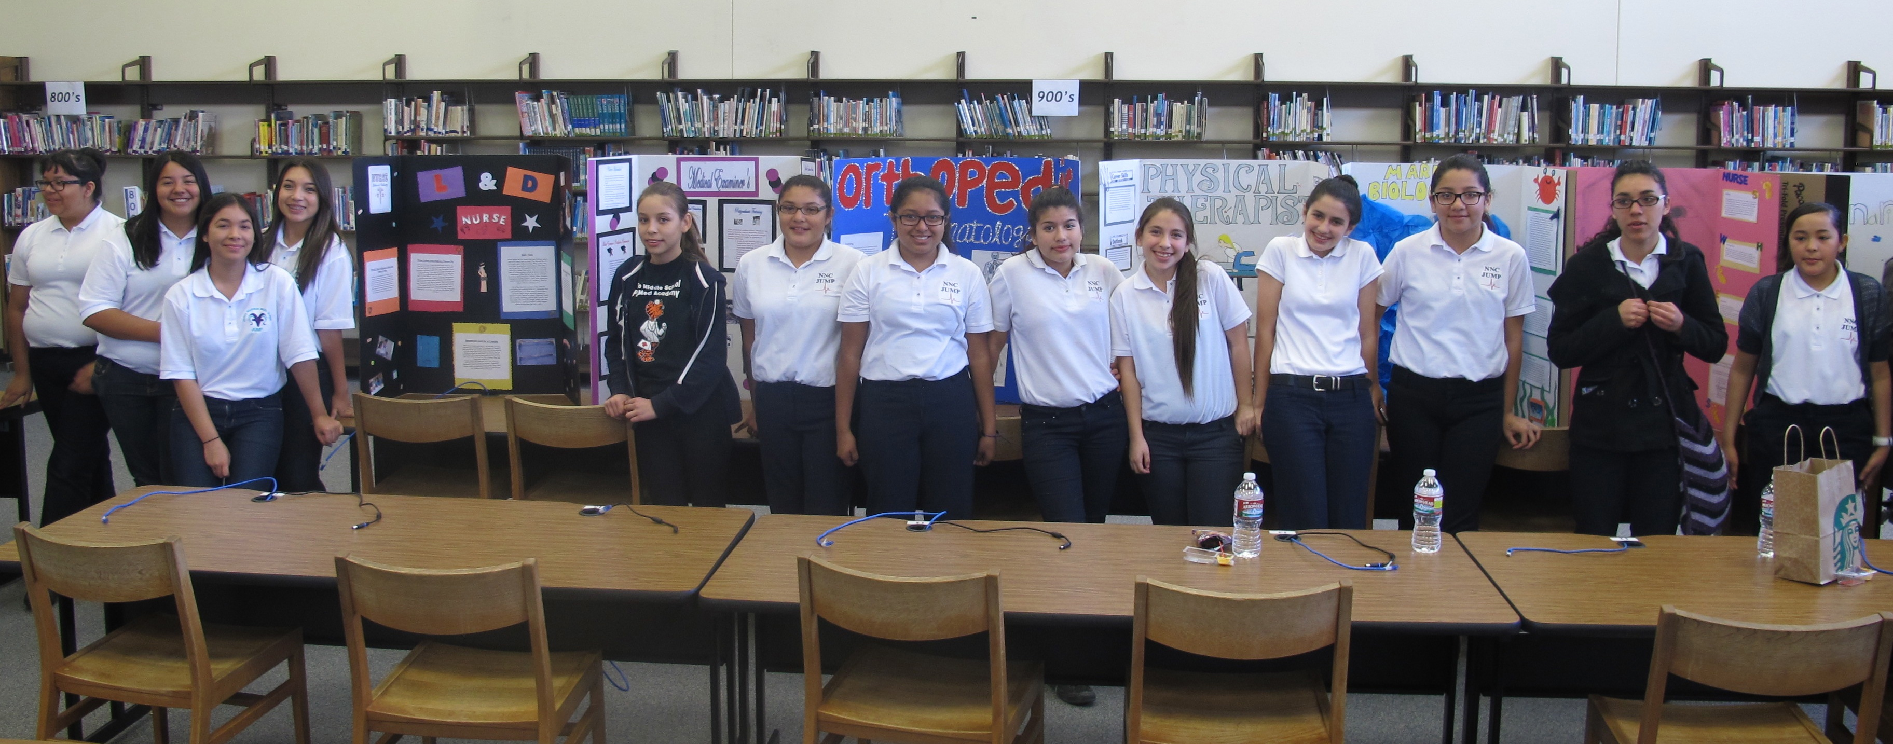
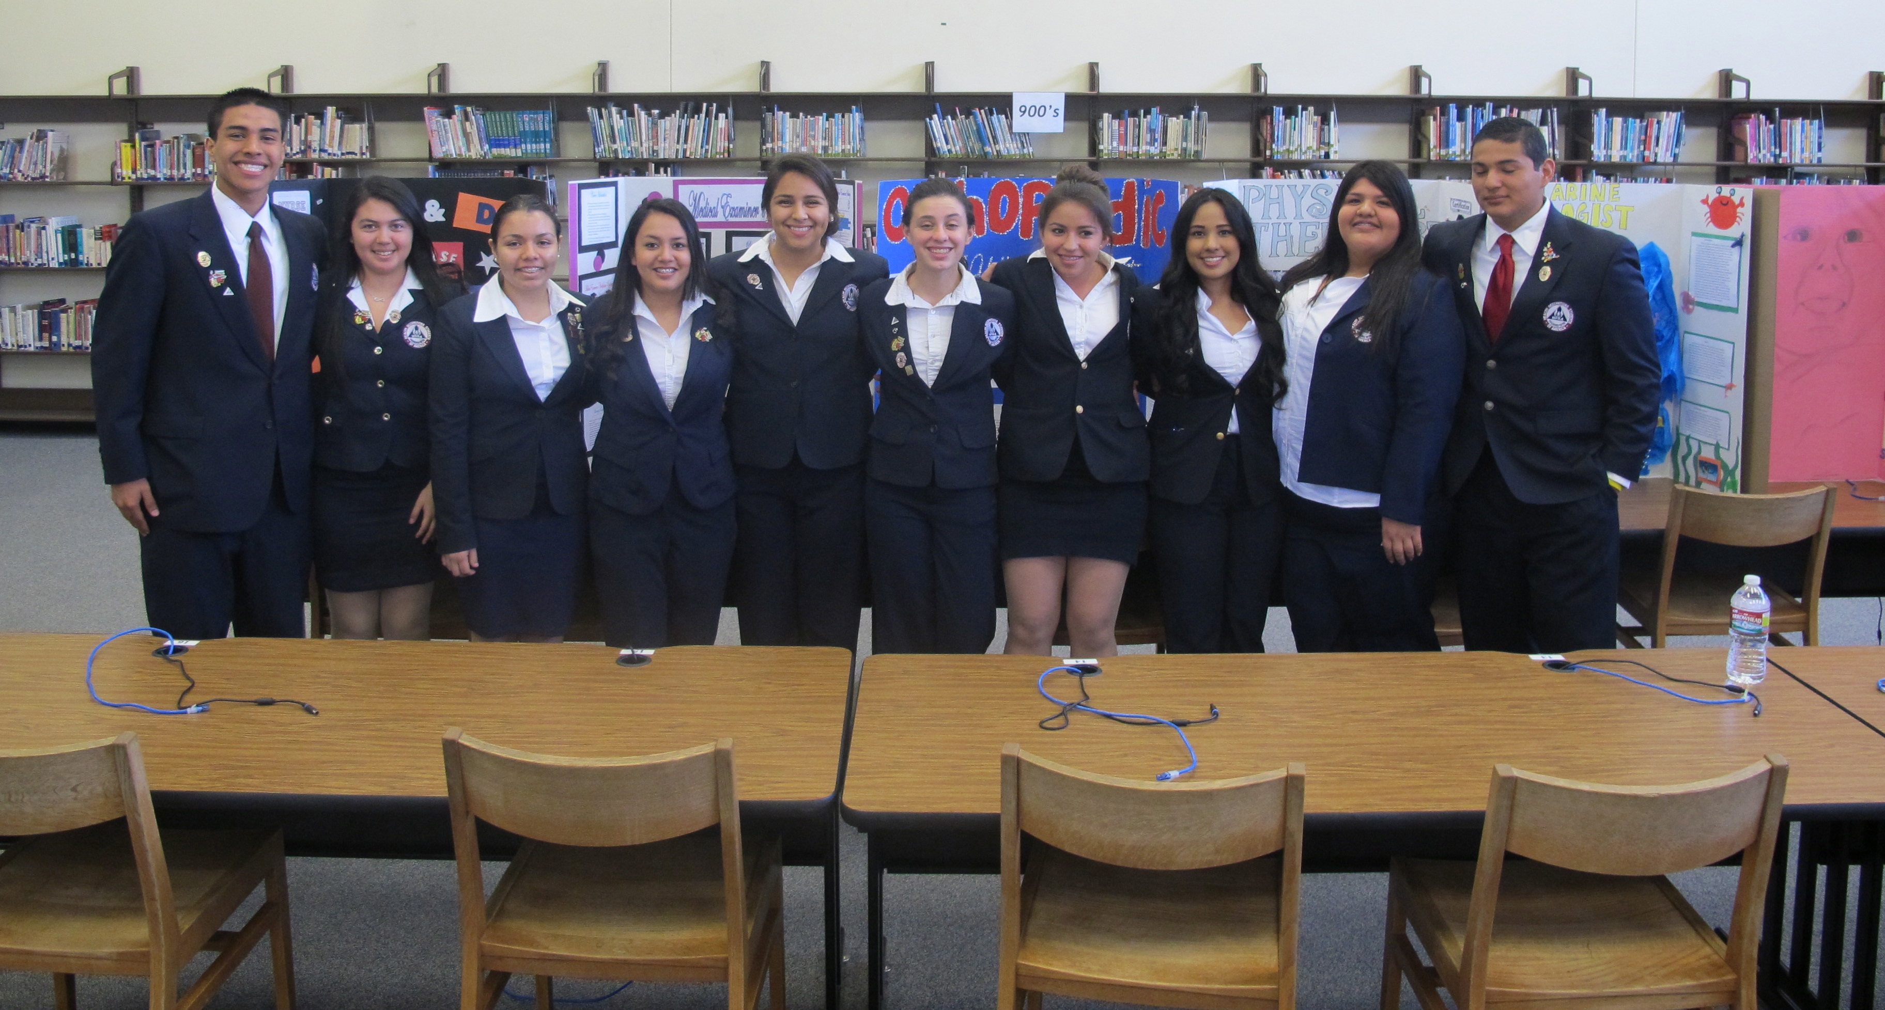
JUMP + HOSA = teamwork
photo
photo
Notes:
Last month we had a regional JUMP competition with 4 middle schools, HOSA students were judges. Competed in medical terminology, extemporaneous health poster, career health display & prepared speaking.

Slide 11
25 PIECE PUZZLE OF WORK-BASED LEARNING
9TH GRADE
PROFESSIONAL
INTERVIEW
DAY
9TH GRADE
LOCAL
COMMUNITY COLLEGE
TRIP
9TH GRADE
CAREER
PROJECT
Notes:
Ruth - Career project – include description in forms folder. Begins with careercrusing, includes other research, ends with creation of display board and/or brochure coupled with oral presentation to the combined HEAL freshman classes.
Donna – Professional Development Day
Ruth – community college trip to see local campus & tour nursing sim lab

Slide 12
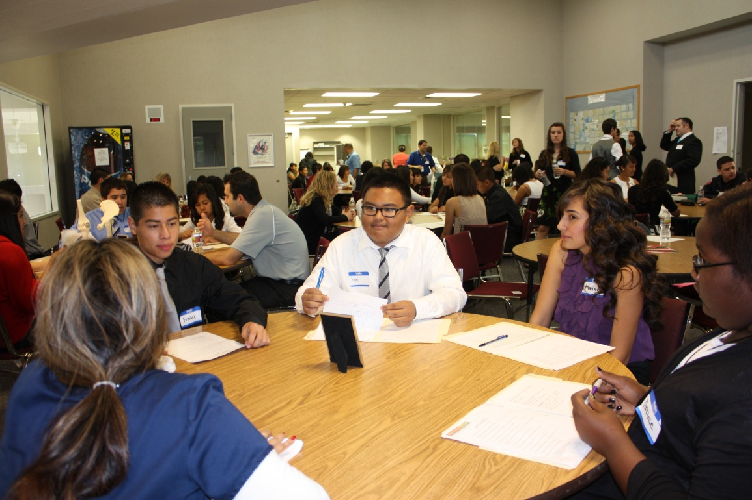
PROFESSIONAL INTERVIEW DAY
68 Students; 21 Professionals
(Pictured here: District Coroner with Freshman HEAL students)
It’s so exciting for the freshmen to meet local industry professionals who embody the careers they dream about.

Slide 13
25 PIECE PUZZLE OF WORK-BASED LEARNING
10TH GRADE
GUEST
SPEAKERS
10TH GRADE
3-DAY COLLEGE TRIP
10th GRADE
SALTON SEA
RESEARCH &
FORUM
10TH GRADE
SERVESAFE
CERTIFICATION
Notes:
Ruth – 10th gr teacher invites about 20 professionals to talk to the students, ranging from medical to environmental to business/legal – cover all aspects of health & environmental health careers. Speakers discuss their jobs, their paths thru college & students have prepared questions. Speakers come from personal contacts among HEAL staff, parents & even students as well as from our CVEP connections.
College trip – includes students & parents, exploring college campuses motivates & informs both.
Salton Sea research ties in environmental health aspects of air/water borne diseases & impact of environmental issues on community health – students do research in teams on variety of aspects from fish die-off, to water & air issues to political/legal issues around the mitigation plans, they prepare a team presentation with visual aids; entire class visits the Salton Sea for informative presentations & to collect water samples which they test in science class later. Culminates in community forum where student teams present their findings to peers, education & community members. Last week 2 students attended a special community forum sponsored by local business & legislators & were able to talk directly with the assistant to our local Assemblyman who now wants to help mentor around this strand.
Donna-building valley wide with our green academies?
Ruth – in search for certifications for sophomores, looked at tying the food borne illness component with students studying servesafe & testing for certificate which in turn makes them good candidates for the kinds of part-time jobs HS students often seek

Slide 14
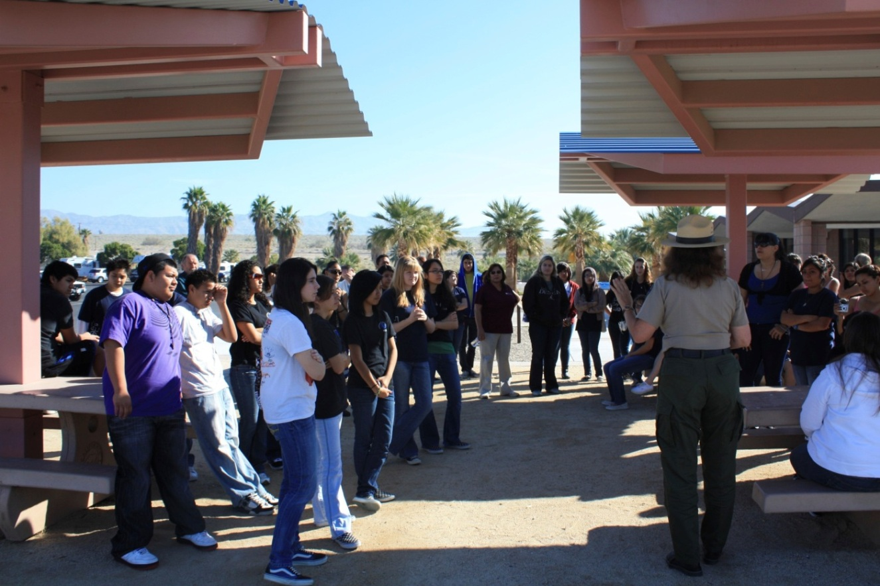
Students & teachers prepare water sample to take back to school for analysis.
Students learn about the Salton Sea and water issues around the globe from Ranger Freida

Slide 15
25 PIECE PUZZLE OF WORK-BASED LEARNING
11TH GRADE
ROP/CTE
CERTIFICATION
11TH
GRADE
MENTORSHIPS
11TH GRADE JOB SHADOW DAY
11TH GRADE CERT TRAINING WITH CCFD
11TH GRADE
COLLEGE
VISITS
Notes:
Ruth – ROP medical term/1st responder – incudes certification CPR/AED/first aid. Combine with CCFD Teen CERT training & certification. Full day mock drill under direction of CCFD personnel. Students use this both as option for HOSA competitive event & activities in senior year.
Donna – Job Shadow process of connecting with industry partners, PR component, discuss forms
Ruth – Job shadowing outside the box – using on-campus professionals such as APE, school nurse, school psychologist, school speech therapist. If we don’t have enough sites for all students, those with D/F in 2 or more HEAL classes, stay on campus & are given similar assignment using careercruising.
Ruth – mentorships – has been one of our challenges, UCR has Health Science Partnership program that has provided pre-med & medical school students who visit our juniors monthly. Talk about college, do project based learning activities, act as hosts when we visit campus. Old enough to be experienced but young enough to relate to & when we visit UCR campus they act as hosts & improves rate of students who apply locally to UC. E-mentorships being tried by some of our other valley academies, our DATA academy has a retired industry partner who mentors on a weekly basis in the classroom.

Slide 16
Cathedral City Fire Dept. doing CERT training with HEAL juniors

Slide 17
25 PIECE PUZZLE OF WORK-BASED LEARNING
12th
GRADE
INTERNSHIPS
12TH GRADE
COMMUNITY
HEALTH FAIR
SCHOOL
DISASTER
DRILL
SCHOOL BLOOD DRIVE
Notes:
Internships – Donna – (program menu)
Ruth – on-campus opportunities, example of student stories (Laura & Viri getting hired, Jorge w/SH student changing career goals), Sulyma in ED,
use of summer internship options for those students in marching band, multi-sport athletes. Goal is minimum 100 hours
Disaster Drill – Ruth – how our seniors put training into practice, PR aspect helps build more community & industry support.
Donna – talk about Dr. Carreon elementary & JFK disaster drill
Health Fair – (get forms) – culminating project that brings together all their personal skills to bring health/wellness to community. Last month we had 30 vendors, marketed to our own students, our feeder middle & elementary schools & the community in general via CVEP & student/family contacts.
Our ASB sponsors 4 blood drives each year with our community blood bank; last year one of our juniors was in ASB & decided to include HEAL students who were trained to take vital signs & monitor patient status to help in the “canteen”. This reduced by a large # the students & staff who returned to class & later experienced post donor symptoms. Blood bank personnel & school nurse & site administrators are very enthusiastic, even better this year & the young lady who started it, now a senior, has trained 2 current juniors to take over; developing a plan to will allow new students to train others behind them.

Slide 18
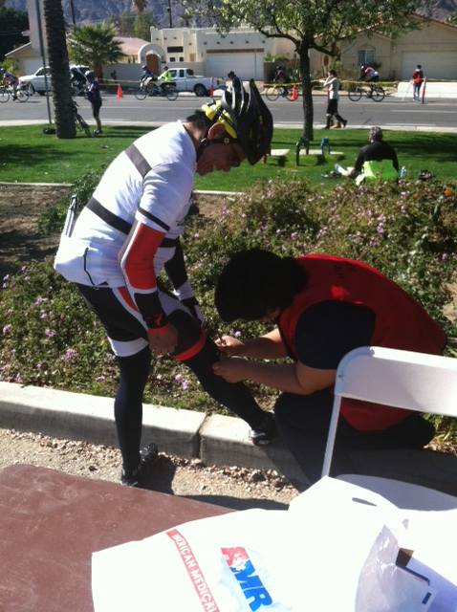
Disaster Drill – CERT in action
Seniors provided first aid for cyclists at the Tour de Palm Springs

Slide 19
25 PIECE PUZZLE OF WORK-BASED LEARNING
HIGH SCHOOL
CTSO
HOSA
CAL-HOSA
SLC
AND
HOSA NLC
POST-SECONDARY
PLANNING
COMMUNITY
SERVICE
Notes:
Planning – Ruth -HS Counselor Role of college/career planning. Classroom visits, careercrusing, CSUmentor, california colleges, transcript discussions, PSAT/SAT/
ACT. Summer assignment before senior year to complete resume & write scholarship essay and/or UC personal statements.
HOSA – leadership, competitive events, the networking & workshops at conferences = 21st century skills + technical skills
SLC & NLC advantages for students & overall program.
Community Service – work skills, teamwork; HEAL requires 25-50 hours per school year, summer and/or school year activities. Use of logs to help students track their hours & activities to use later when they prepare their resumes using careercruising. Tour de PS – PR from last year’s disaster drill led to invitation from TDPS to man their “first aid stop/go stations”. This unique community service activity resulted in a donation from TDPS to help with our Senior Academy Awards. This year we manned all the stations & helped fund-raise for the event itself.

Slide 20
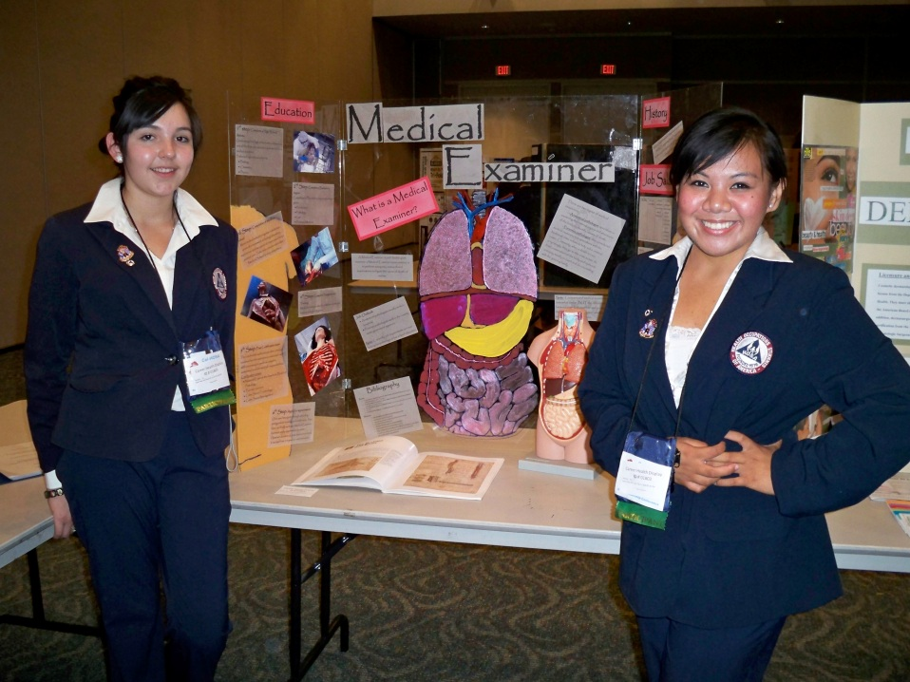
Students who volunteered to help at the CAPA conference were invited to get in on the suturing training.
HOSA builds future health professionals with confidence and poise.
2 students present their Career Health Display

Slide 21
25 PIECE PUZZLE OF WORK-BASED LEARNING
REGIONAL
COLLABORATION
EXTERNSHIPS FOR
EDUCATORS
Notes:
Donna – HALT collaborative, creation of EHP’ program out of HCC & what they are doing with current academy students, i.e. created valley-side career fair.
Educator Externships - Donna

Slide 22
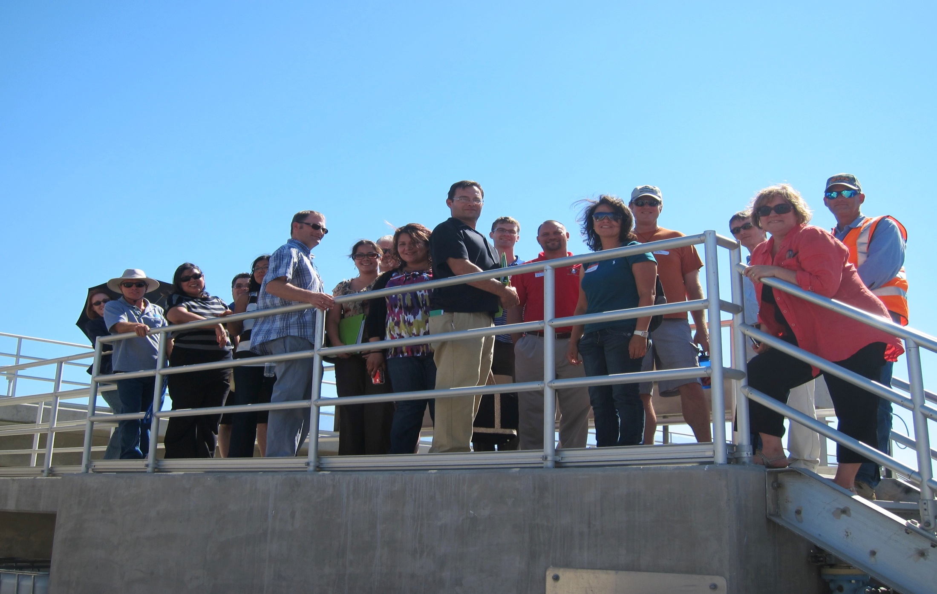
Faculty Externships

Slide 23
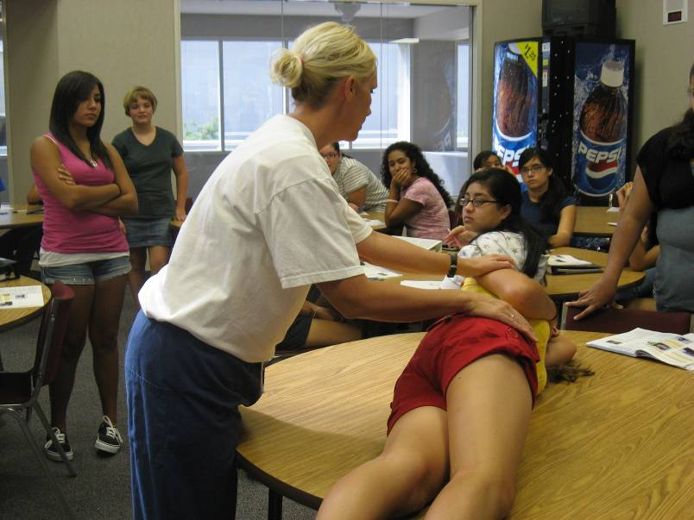
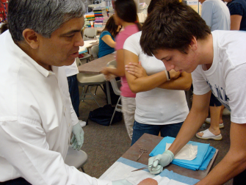
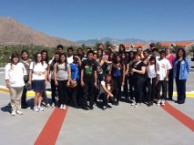
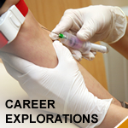
10,000+ hours
Work Based Learning
Provided by
Coachella Valley Employers
in 2011
Notes:
Reference Program Menu

Slide 24
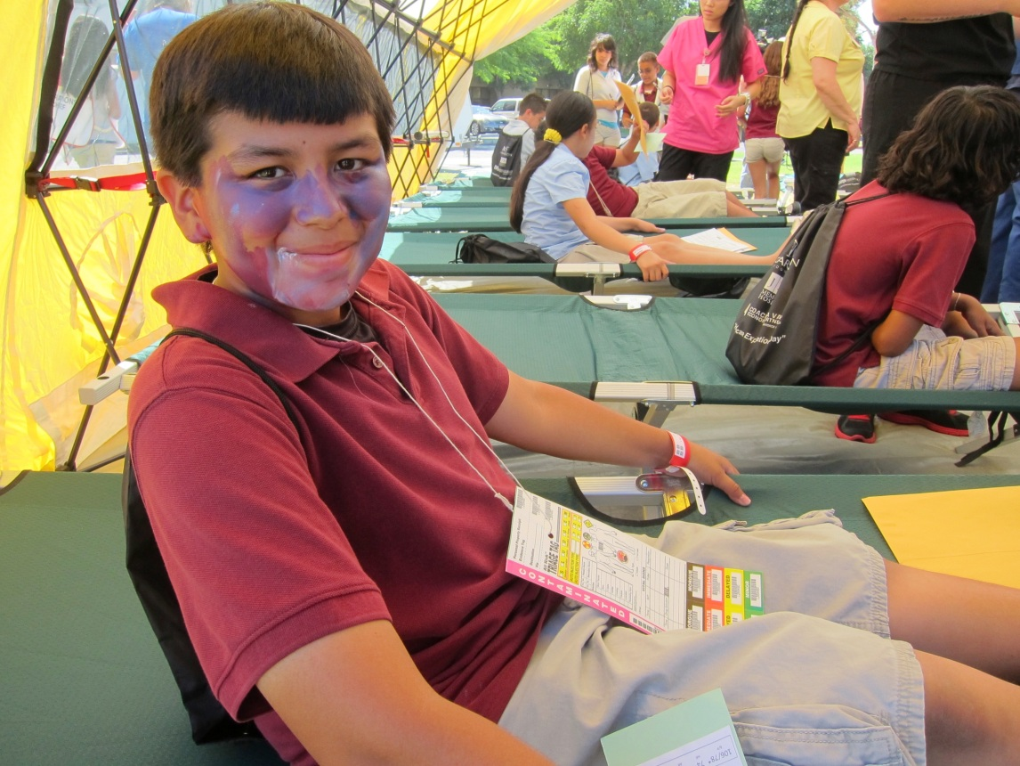
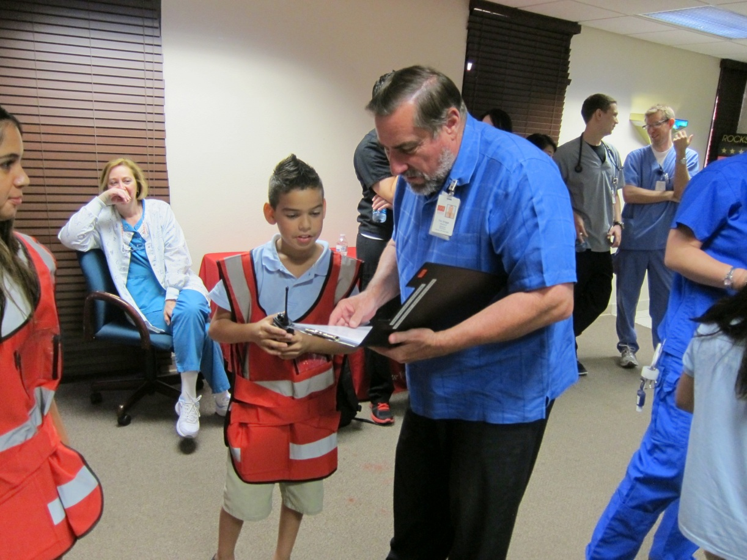
JFK /Dr. Carreon 5th Grade Disaster Drill

Slide 25
25 PIECE PUZZLE OF WORK-BASED LEARNING
PUT TOGETHER YOUR OWN PUZZLE PIECES
EDUCATION
COMMUNITY
STUDENTS
INDUSTRY
Notes:
Distribute blank puzzle pieces & give attendees opportunity to meet w/others at table to discuss what puzzle pieces are their priorities or “wish list” & write on the pieces to take back to school for future discussion with their teams. (15-20 minutes?)

Slide 26
25 PIECE PUZZLE OF WORK-BASED LEARNING
RESOURCES AND CONTACTS:
Ruth Kwake - rkwake@psusd.us; Palm Springs Unified School District
Donna Sturgeon – donna@cvep.com; Coachella Valley Economic Partnership
HOSA – www.HOSA.org. And www.CalHOSA.org (this includes JUMP info)
CVEP (Coachella Valley Economic Partnership – for information and resources for business partnerships - www.smartstudentsgreatjobs.org
CERT -
Puzzle source - http://www.amazon.com/Inovart-Puzzle-It-Blank-Puzzles-Pieces/dp/B00598K9YK
Educating for Careers website for this powerpoint & examples of forms : www.educatingforcareers.org
Notes:
A few resources to help you with your ideas.
Feel free to contact us for more information or if you’d like to visit & see how we work in HEAL and/or in our regional collaborative.

